Slide 1
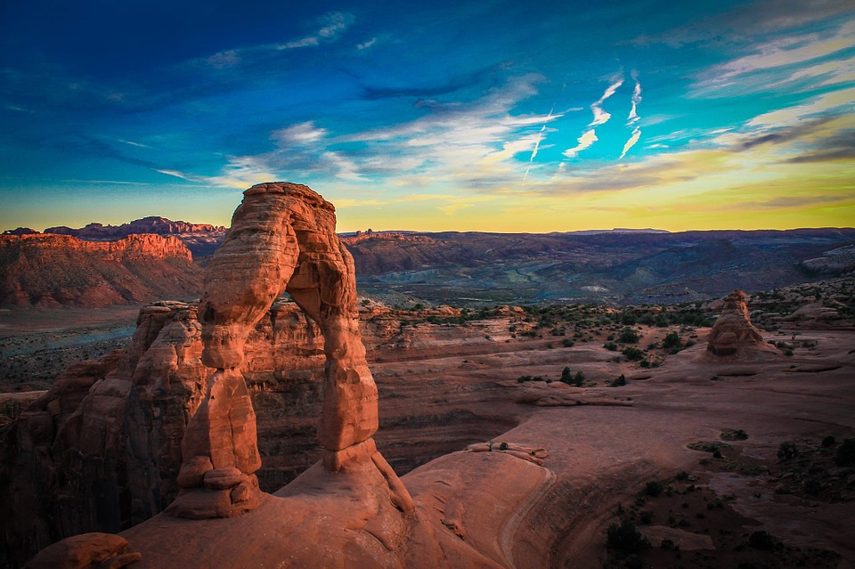
Weathering, Erosion, and Deposition

Slide 2
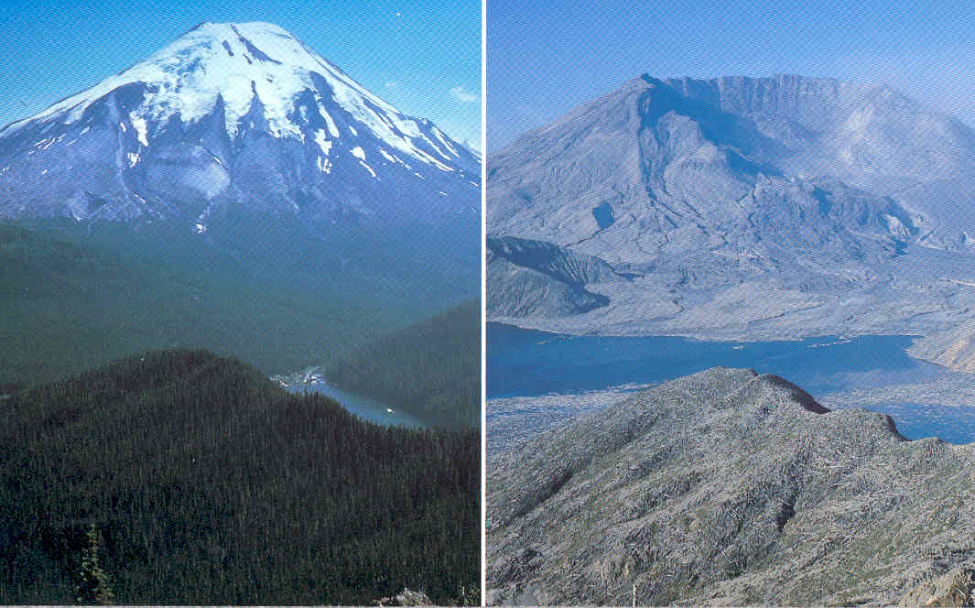
The Earth’s surface is constantly changing.
Here is Mount St Helens before and after it erupted in 1980.

Slide 3
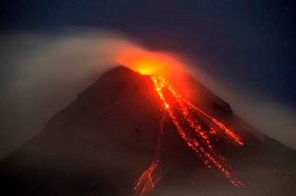
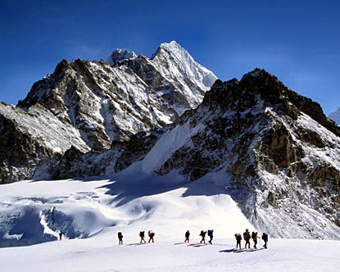
New land is constantly being formed.
Volcanoes erupt.
Forces deep in the Earth push up chains of mountains.

Slide 4
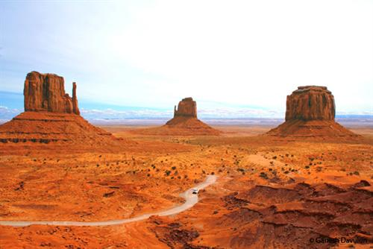
Land is being constantly worn down by wind, water and ice.
original level of the plateau.

Slide 5
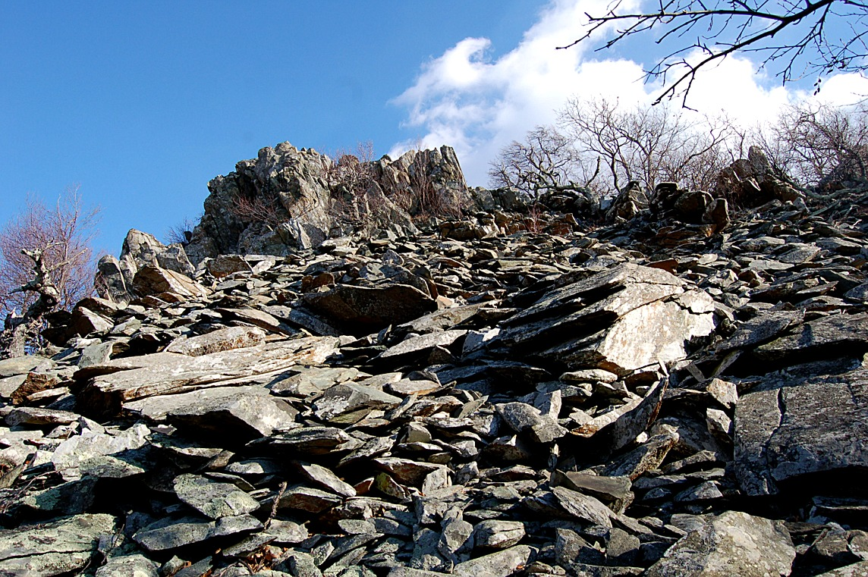
Weathering
- The breaking down of rock into smaller and smaller pieces.

Slide 6
Things in nature that cause weathering:
    Water in cracks of rocks can freeze and expand
    Plant roots grow into rocks
    Water runs over rocks, causing rocks to hit each other and break into smaller pieces
    Wind carries sand and wears down rocks
    Carbon dioxide dissolves in water and creates acid that eats holes in rocks

Slide 7
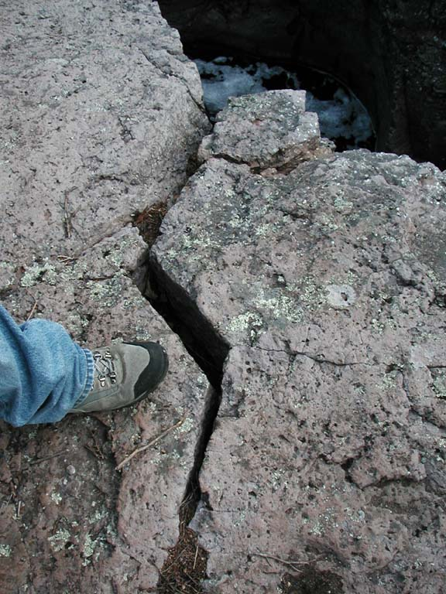
Water in cracks in the rock freezes.
As it freezes it expands causing the rocks to break.

Slide 8
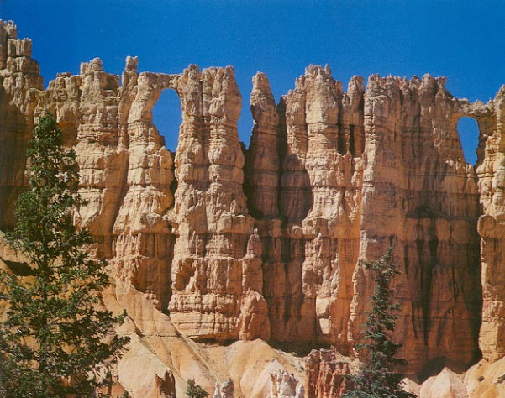
Expanding water as it freezes slowly breaks up this rock into unusual shapes.
Frost Action or ice wedging slowly breaks up this sedimentary rock into unusual shapes.

Slide 9
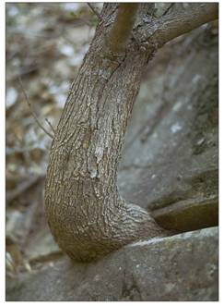
Plant roots break apart rocks

Slide 10
Weathering by running water
When water in waterfalls, rivers and streams move over rock, the rocks are weathered—broken into smaller and smaller pieces.

Slide 11
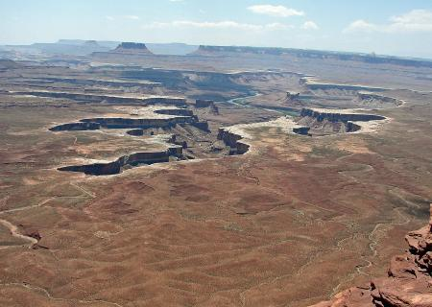
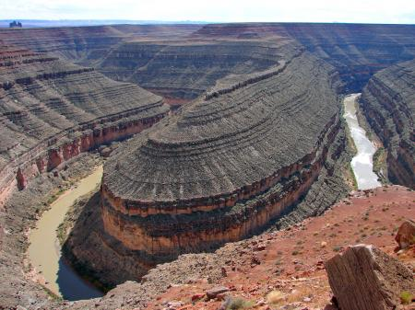
Fast running water causes rocks to hit one another breaking them into smaller rocks.

Slide 12
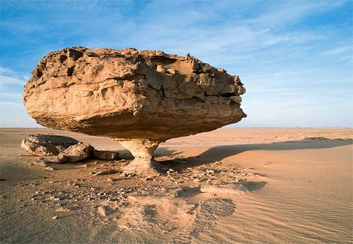
Weathering by the wind
As the wind blows it picks up small particles of sand and blasts large rocks with the abrasive particles, cutting and shaping the rock.

Slide 13
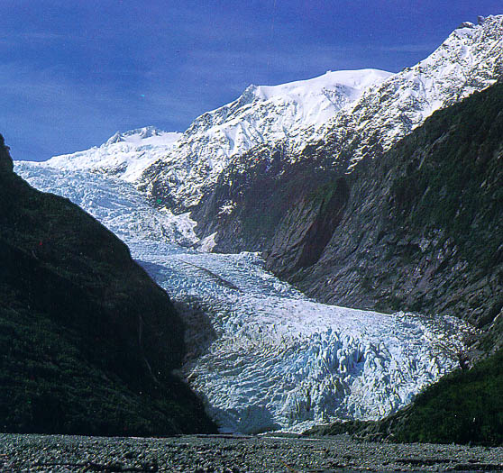
Weathering by glaciers
A glacier is a large, river of ice that moves very slowly downhill.
Glaciers are formed over many years as large amounts of snow fall and accumulate. The snow compacts and changes to ice.
Stuck in the bottom of the glacier are stones of various sizes that wear away the rock under the glacier as it moves downhill.

Slide 14
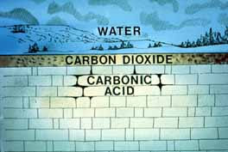
Carbon dioxide that dissolves in water weathers rock
CO₂ dissolves in rain water and creates carbonic acid
Carbonic acid easily weathers limestone making holes in the rock

Slide 15
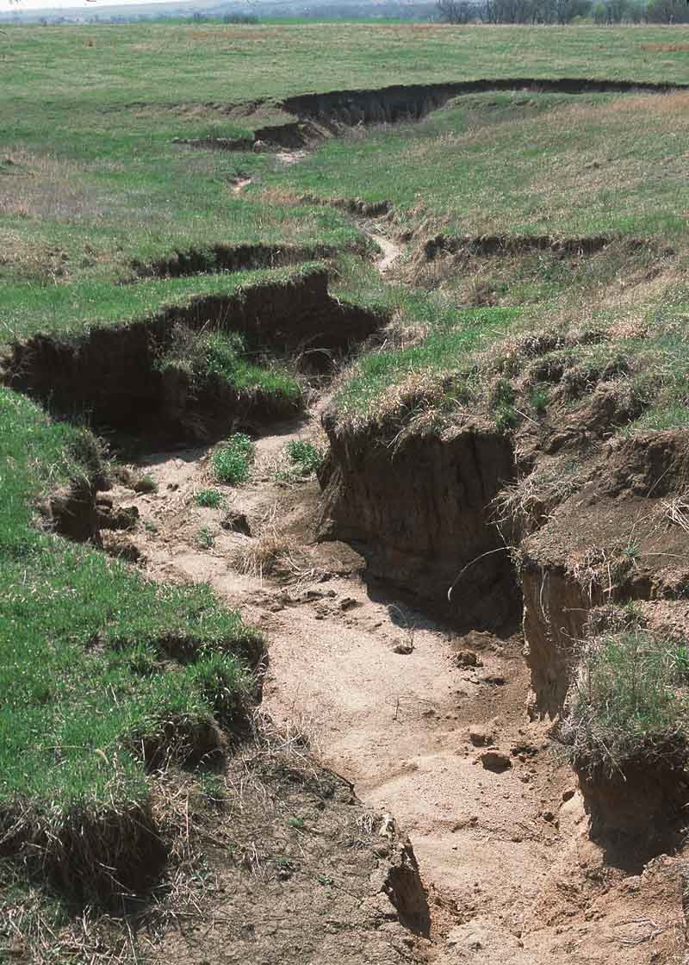
Erosion
The process by which water, ice, wind or gravity moves pieces of rock and soil.
When rock is weathered (broken into smaller and smaller pieces), these pieces are often carried away by water, wind or ice.

Slide 16
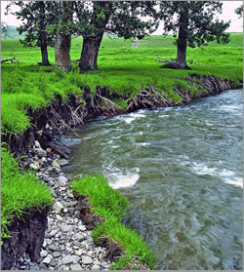
Water Erosion
Rivers, streams, and runoff carry weathered rock or soil to another place.

Slide 17
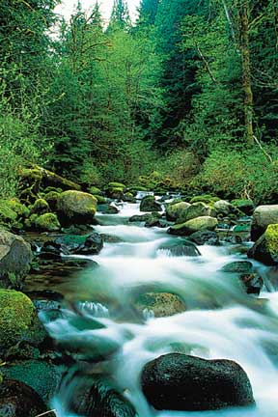
Fast moving streams and rivers carry big and small rocks downstream.

Slide 18
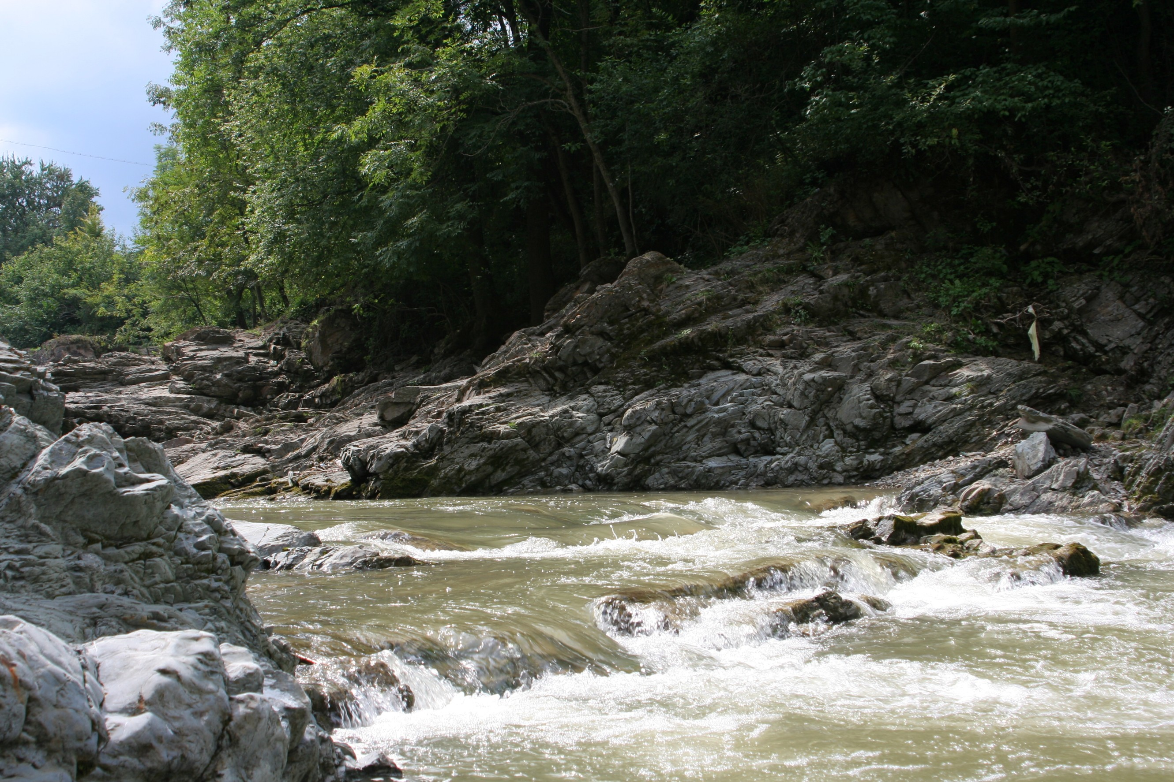
Slower moving water carries smaller rocks and soil downstream.

Slide 19
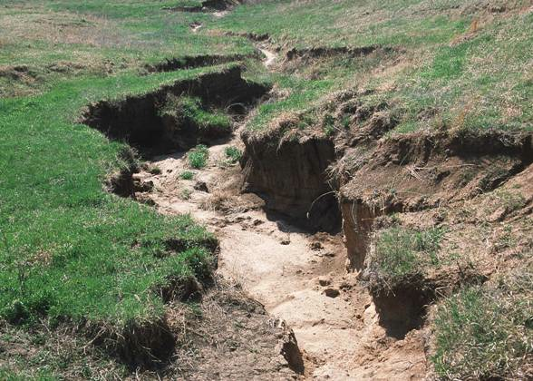
Moving water can also cause soil erosion—carrying the soil away to a different location.

Slide 20
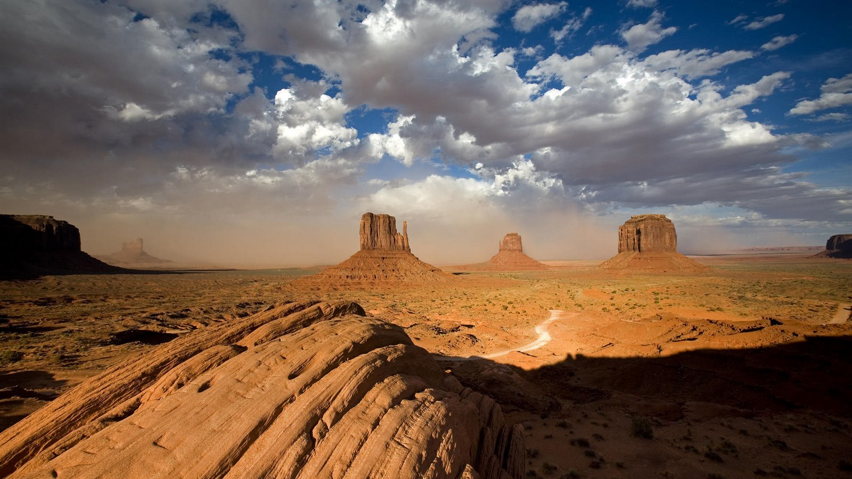
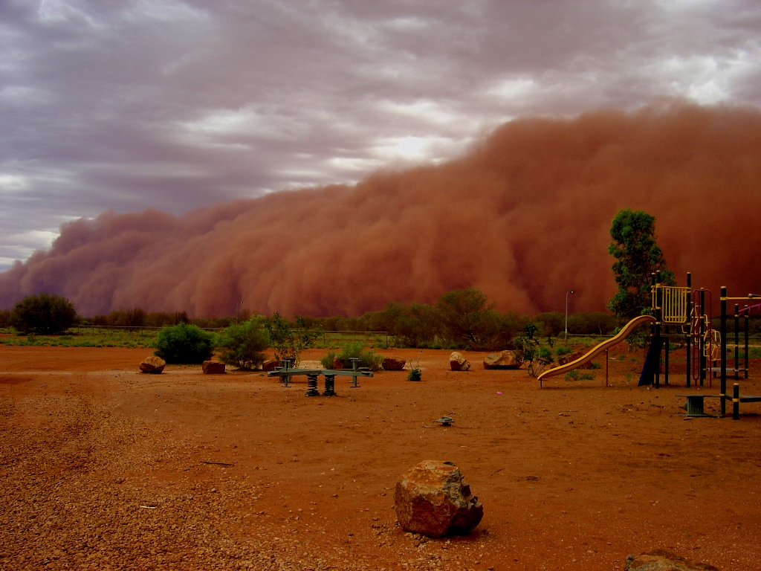
Wind Erosion
Strong winds can move small rocks and soil from one location to another.

Slide 21
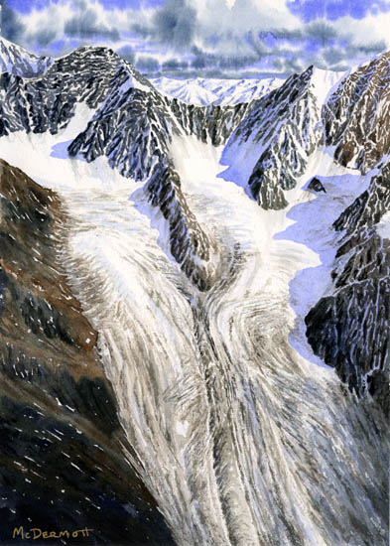
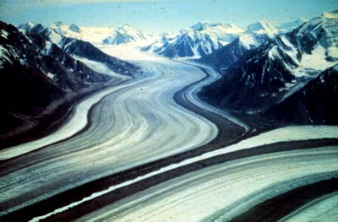
Ice Erosion
Glaciers moving over rocks breaks them down into smaller pieces (weathering) and carries them away (erosion).

Slide 22
Deposition
- When the water slows down or stops moving…
- When the wind dies down or stops blowing..
- When the glacier melts…
the rocks that the water, wind or glacier were carrying are dropped or deposited in a new location.

Slide 23
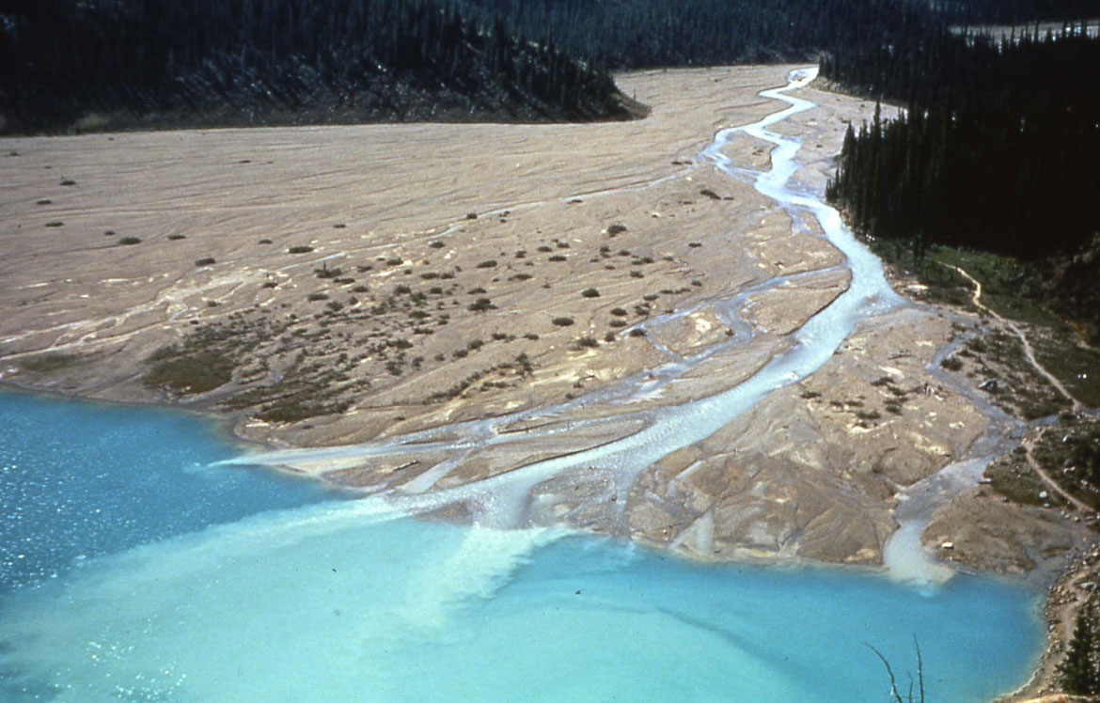
Delta—water deposition
Where a river meets the ocean is called the mouth of the river. Soil carried by a river is deposited at the mouth and new land is formed. This new soil-rich land is known as a delta.

Slide 24
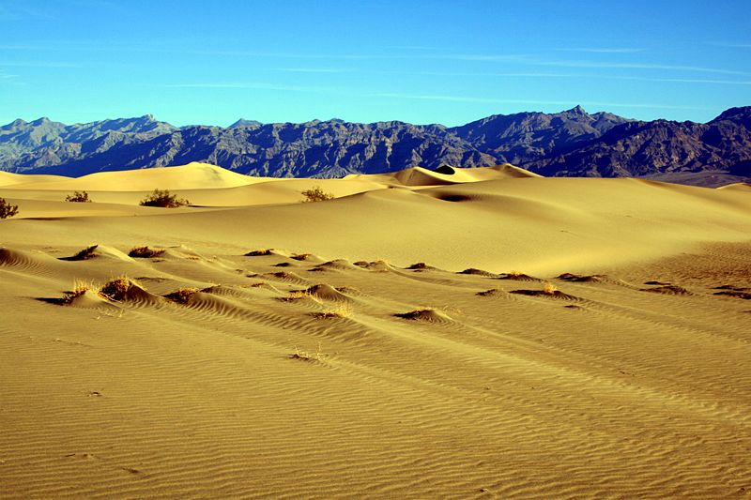
Wind Deposition
Sand dunes are large deposits of sand dropped when the wind stopped blowing. The location of the sand dunes shifts frequently.

Slide 25
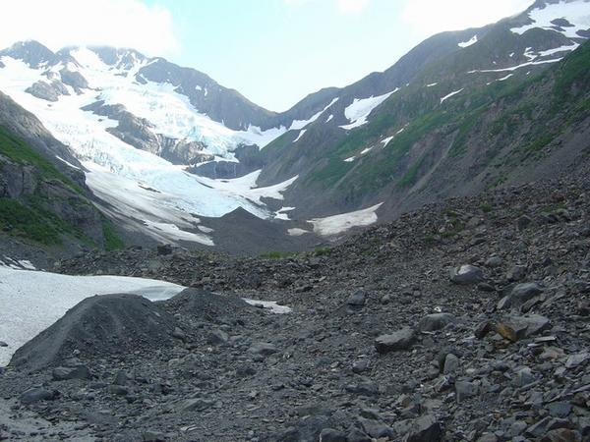
Glacial Deposition
When glaciers melt, they drop or deposit the rocks they were carrying.

Slide 26
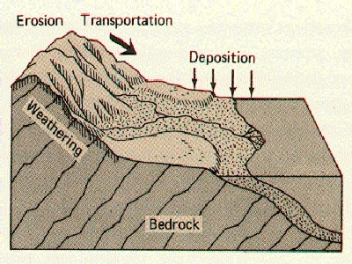
Although we talk about weathering, erosion and deposition as three separate processes, they often occur together. Over time, rocks are generally broken into smaller pieces (weathering) carried downhill (erosion) and deposited in a new location (deposition).

Slide 27
Do you remember the agents of weathering that we discussed?
moving water in streams and rivers
water in cracks in rocks freezing and expanding
glaciers
plant roots
wind
Do you remember the agents of erosion that we discussed?
moving water in streams and rivers
wind
glaciers

